Slide 1

DYNAMIC
LINK
LIBRARY

Slide 2

What is DLL?
A dynamic link library (DLL) is a collection of small programs that larger programs can load when needed to complete specific tasks. The small program, called a DLL file, contains instructions that help the larger program handle what may not be a core function of the original program.

Slide 3
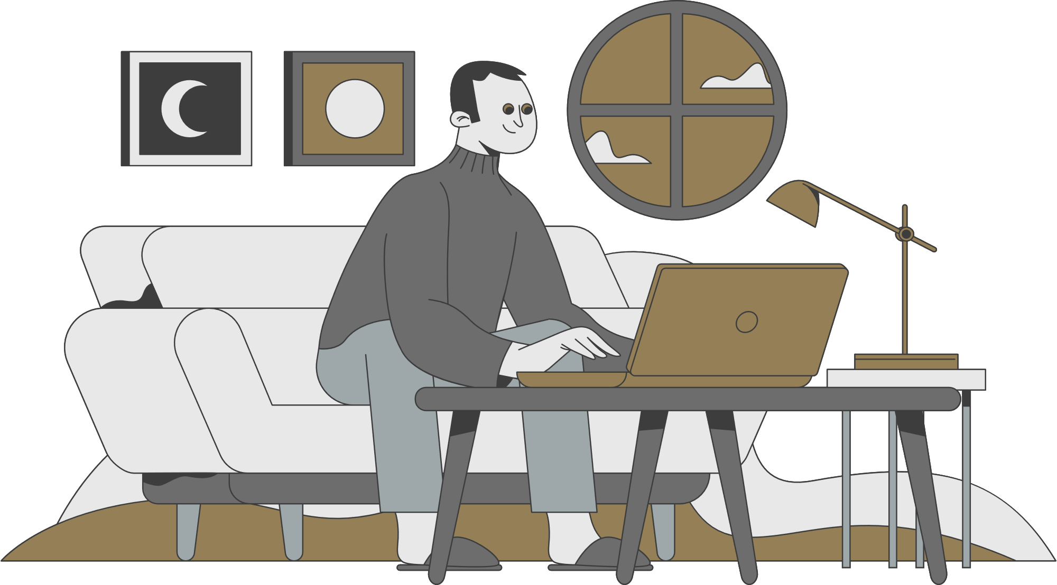
What is our Objective?
C
.DLL
Java
C File
DLL File
Java File

Slide 4

JNI stands for Java Native Interface.
At times, it is necessary to use native (non-Java) codes (e.g., C/C++) to overcome the memory management and performance constraints in Java. Java supports native codes via the Java Native Interface (JNI).
JNI

Slide 5
Step 1: Create Java File and write the native method which you want to implement

Slide 6
Step 2: Create a header file by writing a simple command in terminal
-> javac -h . JavaNative.java

Slide 7
Step 3: Implement this native method in C using the header file which was previously generated by the terminal

Slide 8
Step 4: Implement and define this native method in C using the header file which was previously generated by the terminal and after implementation then compile the code

Slide 9
Step 5: After Compilation of
code we need to create a DLL to do this we need to write a following command in terminal
-> gcc -o libJNI.dll -shared -fPIC -I"C:\Program
Files\Java\jdk-18.0.1.1\include" -I"C:\Program
Files\Java\jdk-18.0.1.1\include\win32“
JavaNative.c

Slide 10
Step 6: After the generation of dll file we need to load this in java by the method so called system.load() and then write java code to use this native method and finally compile the code to see the result

Slide 11


